Slide 1
Evaluation of weather forecast with Deep Learning
By:
Pritish Samant

Slide 2
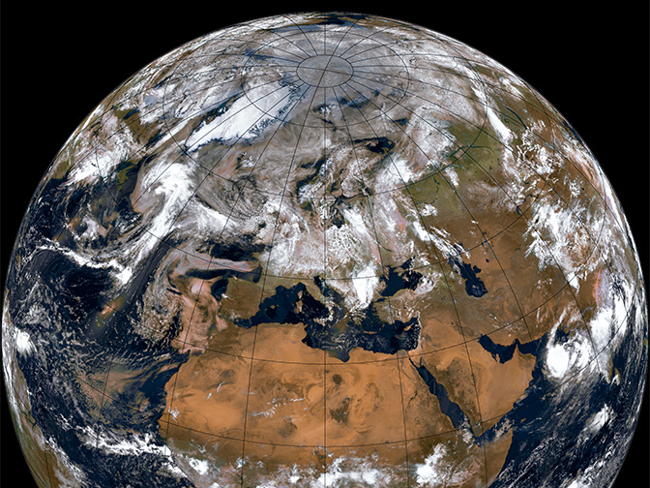
Weather Evaluation
Understanding past, present, and future weather patterns through the collection and analysis of meteorological data is known as weather evaluation.
Accurate and trustworthy weather forecasts are essential for a variety of uses, such as transportation, energy production, agriculture, and disaster preparedness. This is the aim of weather evaluation.
[1]

Slide 3

Weather Evaluation
Because the weather can affect a variety of our daily activities and decisions, it is important to evaluate the weather.
We can prepare for and lessen the possible risks and effects on our everyday activities by keeping an eye on the weather.
Predicting various atmospheric parameters, such as temperature, wind, humidity, clouds, and precipitation, is difficult.

Slide 4
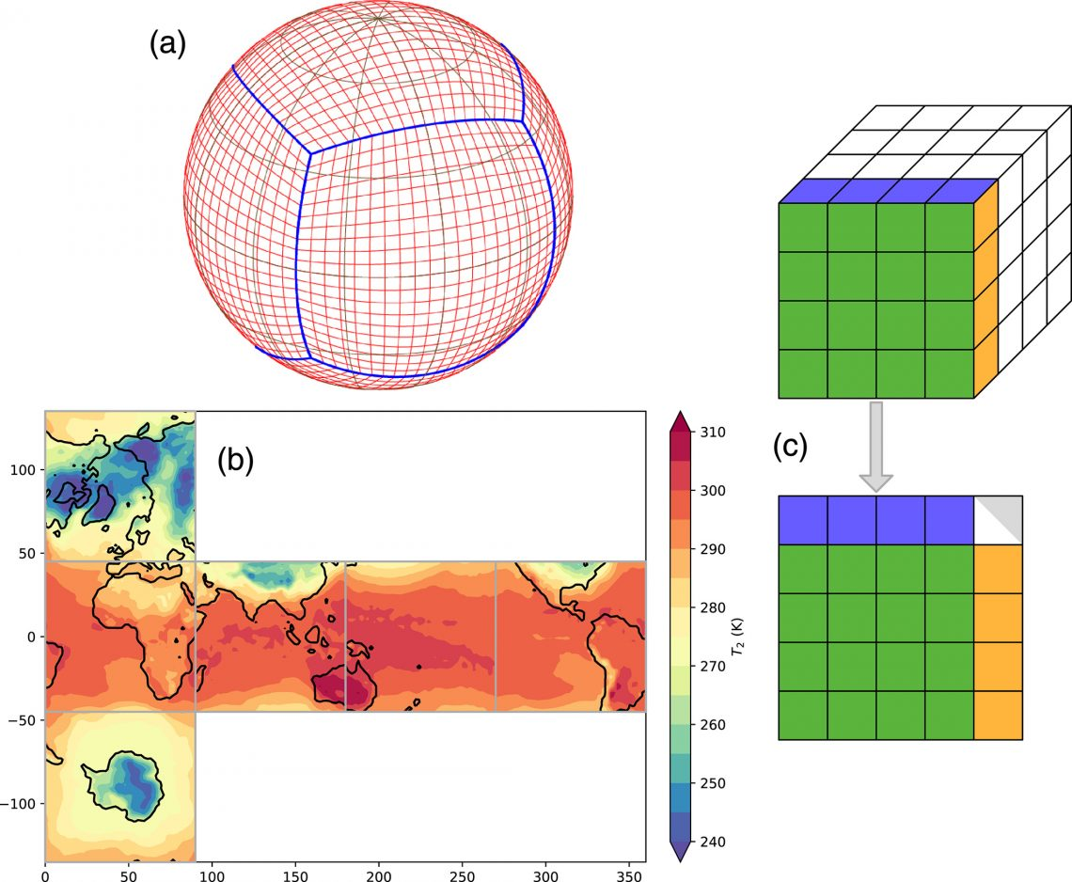
weather evaluation techniques
traditional weather evaluation techniques like manual data collection from weather stations or weather balloons have been used for decades and are still important, they have some limitations.
Limitations of traditional weather evaluation techniques, such as limited coverage, high cost, and susceptibility to human error.
By combining traditional and modern techniques, it is possible to overcome the limitations.
[2]

Slide 5
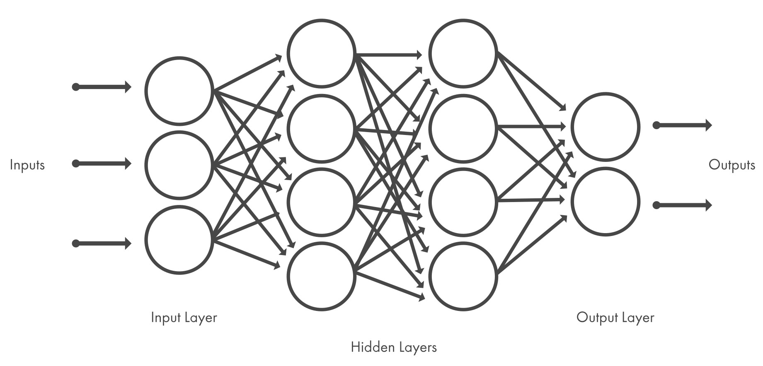
Deep Learning
Deep learning is a type of machine learning that uses artificial neural networks to learn from large amounts of data.
deep learning techniques can automatically learn features and patterns from raw data, eliminating the need for manual feature engineering.
Its ability to process and analyze large amounts of data quickly and accurately has significant implications for various fields, making it a powerful tool for solving complex problems.
[3]

Slide 6
Deep Learning
deep learning has the potential to revolutionize weather evaluation and forecasting by providing more accurate, timely, and comprehensive data.
Deep learning offers several advantages over traditional methods of weather evaluation, including its ability to handle complex data, recognize patterns, and learn from data.
The common models are Autoencoder (AE), Deep Belief Network (DBN), Convolutional Neural Network (CNN), and Recurrent Neural Network (RNN).

Slide 7
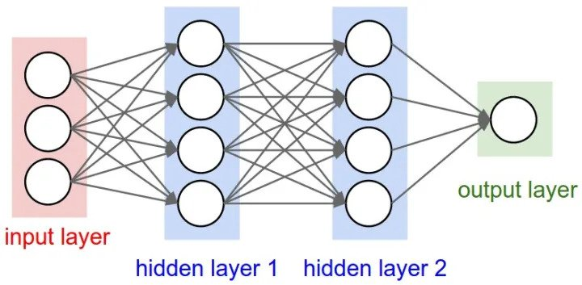
Artificial Neural Network (ANN)
Artificial Neural Networks (ANN) are algorithms based on brain function and are used to model complicated patterns and forecast issues.
There are three layers in the network architecture: the input layer, the hidden layer (more than one), and the output layer.
Data flows through these nodes, adjusting the weights of connections to learn patterns and make predictions.
ANNs excel in complex problem solving such as predictive analysis.
[4]

Slide 8
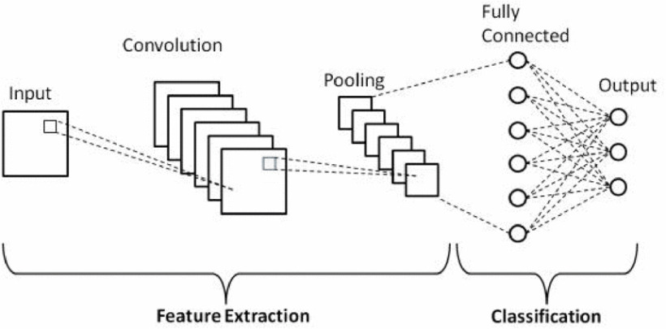
Convolutional Neural Network (CNN)
A Convolutional Neural Network (CNN) is a type of Deep Learning neural network architecture commonly used in Computer Vision.
CNNs are based on three main layers. These are: Convolutional layer, Pooling layer, Fully-connected layer.
one main advantage: It automatically detects features without human supervision.
Used In Computer Vision including image recognition.
[5]

Slide 9
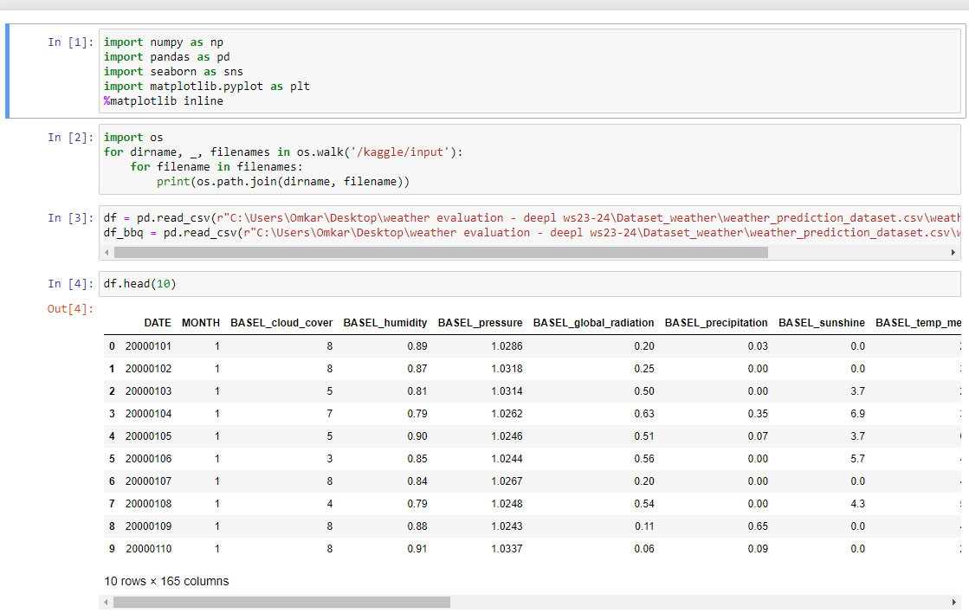
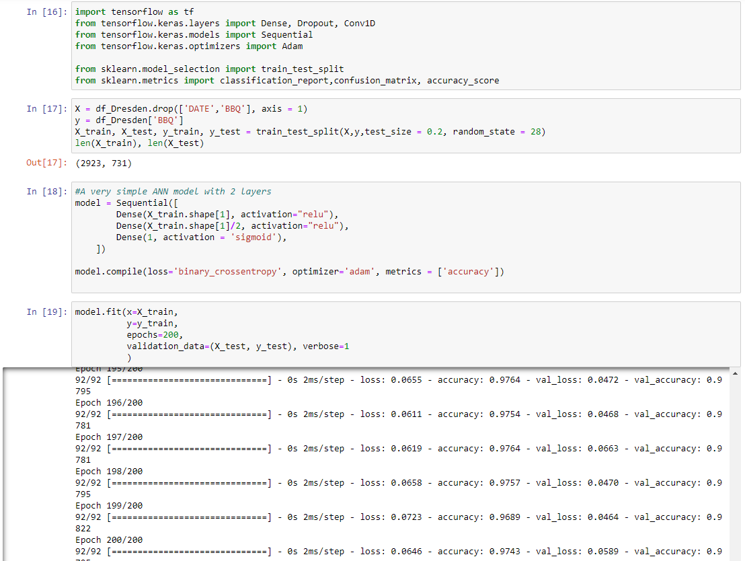
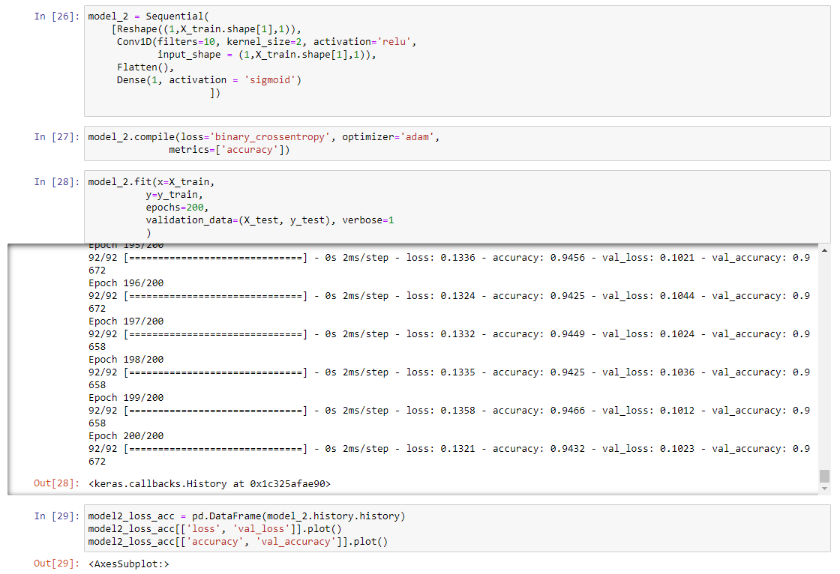
Implementation
ANN
CNN

Slide 10
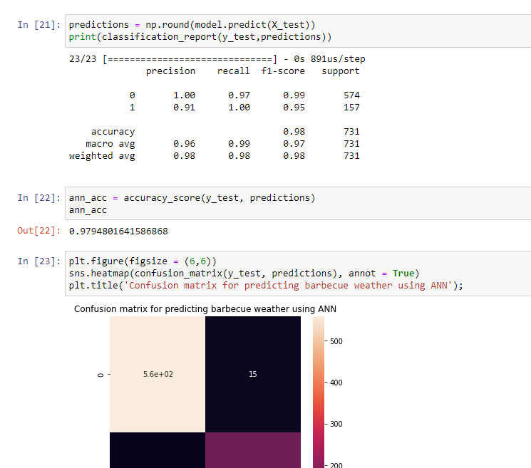
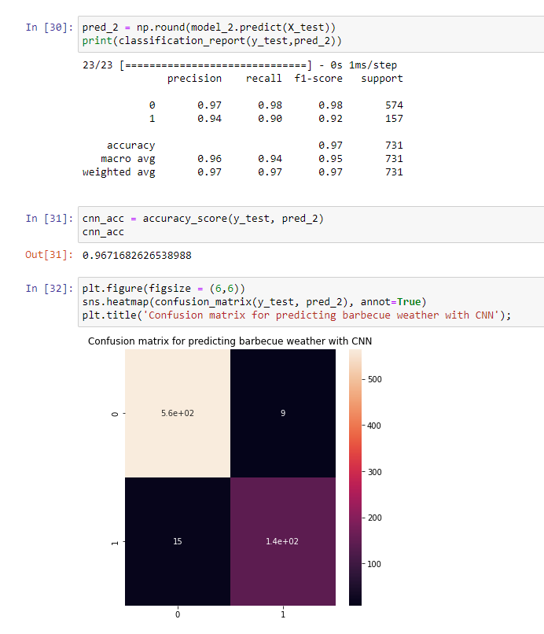
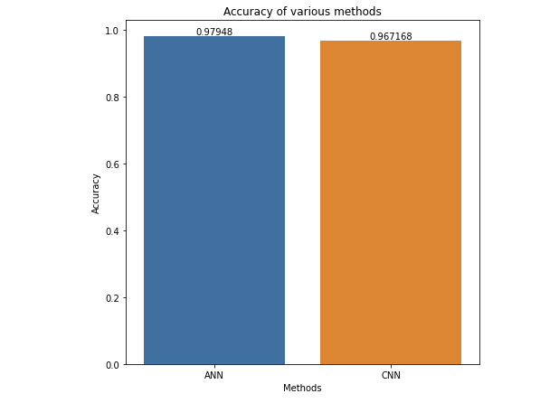
Results
ANN
CNN

Slide 11
Conclusion
More deep learning models need to be designed for weather evaluation as it will prove very important to combat climate change.
Importance of weather evaluation along with its limitations and also how deep learning algorithm helps in weather evaluation.

Slide 12
References
[1] https://www.ecmwf.int/sites/default/files/Metop-view-of-Earth-slider_13.jpg
[2] https://environment.uw.edu/news/2020/12/a-i-model-shows-promise-to-generate-faster-more-accurate-weather-forecasts/
[3] https://de.mathworks.com/discovery/deep-learning.html
[4] https://www.digitaltrends.com/computing/what-is-an-artificial-neural-network/
[5] D. Dai, "An Introduction of CNN: Models and Training on Neural Network Models," 2021 International Conference on Big Data, Artificial Intelligence and Risk Management (ICBAR), Shanghai, China, 2021, pp. 135-138, doi: 10.1109/ICBAR55169.2021.00037.

Slide 13

Thank you!

